Slide 1
HENLEY-IN-ARDEN
JPC TOURISM
Public Toilets Signs

Slide 2
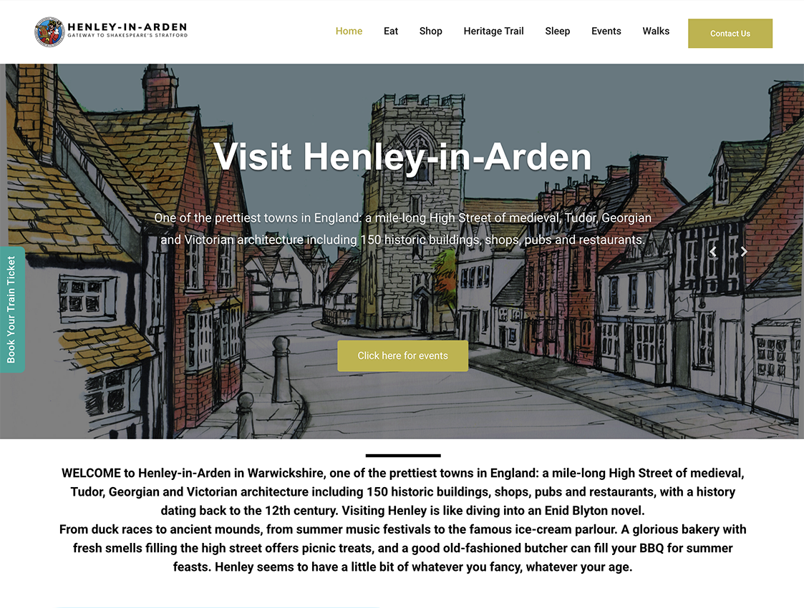
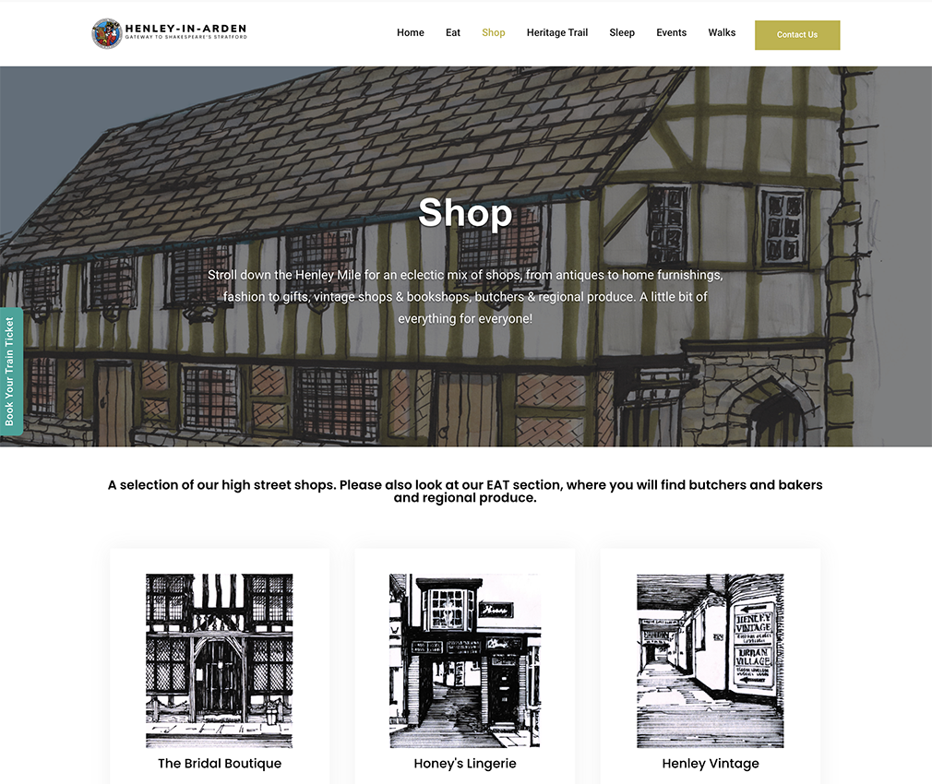
HENLEY-IN-ARDEN
JPC TOURISM
www.visit-Henley.co.uk

Slide 3
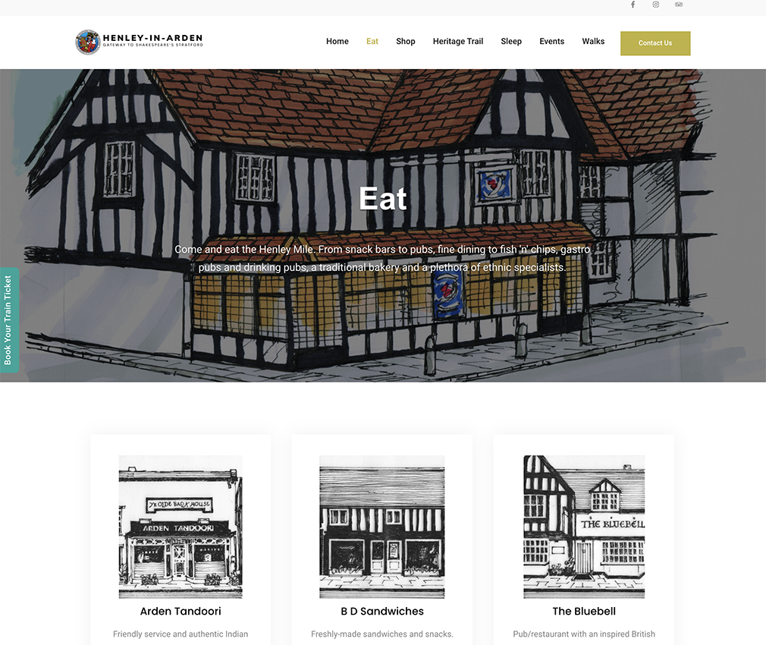
HENLEY-IN-ARDEN
JPC TOURISM

Slide 4
HENLEY-IN-ARDEN
JPC TOURISM

Slide 5
HENLEY-IN-ARDEN
JPC TOURISM
SOCIAL MEDIA
Preferred platforms: Facebook and Instagram
Change local’s perception of the local businesses
Informal chat to local business
Understand their issues
Obtain feedback
Encourage businesses to have offers and news
Promote the businesses to like and share other Henley businesses
Direct referral to the website and shop local
Encourage new visitors to the town

Slide 6
HENLEY-IN-ARDEN
JPC TOURISM
SHOP LOCAL
A campaign to encourage residents of Henley in Arden to shop locally rather than driving to large outlets
Information that drives the following points:
Support local business
Environment
Community

Slide 7
HENLEY-IN-ARDEN
JPC TOURISM
SHOP LOCAL
Henley Attractions Window Sticker
Designed to follow other artwork around the area to promote the Visit Henley website where you can find all the local shops and businesses

Slide 8
HENLEY-IN-ARDEN
JPC TOURISM
SHOP LOCAL

Slide 9
HENLEY-IN-ARDEN
JPC TOURISM

Slide 10
HENLEY-IN-ARDEN
JPC TOURISM
Re-Launch Henley Market
Mission of Tourism Committee
To increase quality footfall and revenue for business within the Parish Council boundaries with a focus on the historic high street

Slide 11
Initial Thoughts
Twice monthly
Farmers Market
Vintage Market
Wednesday or Tuesday to increase beginning of the week footfall
Location suggestions:
Guildhall & Gardens
War Memorial Hall & car park
Henley High School
Buckly Green residents land?
Notes:
Farmers Market for producers – 30 – 50 miles radius
Full basket offering
No street food sellers to encourage trade into high street
Offer butcher etc a stall as first option to take care of local suppliers. Ditto Henley Ice cream etc
Vintage market to be organised by Frankie from Henley Vintage
Guidlhall venue this could under consultation then be extended to the market cross and old market area on one side of the road up until the Three Tuns. But only after initial success and parking are addressed.
Memorial Hall venue this possibly as a wet weather alternative anyway
School Weekends & school holidays only – almost impossible to have a professional compnay organsie at the weekends
Buckly Green probably too far out. But a thought?

Slide 12
Practicalities
Professional market Company
All licences
All insurance
Double check all suppliers licences
Set up and breakdown
Discussion with two of the best
Boffey Arts & Events – Great Malvern
Fresh N Local - Stroud

Slide 13
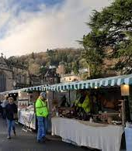
Great Malvern Farmers Market
Additional sponsors
Local Magazine
Local Council
Businesses
Regional food and drink
Notes:
Boffey
Very busy. Not keen, after lengthy conversation may be interested but probably looking for subsidies for stall holders to establish the market. Stall cost for a farmers market via Boffey £39 per stall.

Slide 14
Stroud Farmers Market
Certified farmers market with FARMA
Great PR for Stroud as it has been featured in the Sunday Telegraph, The Observer, The Independent, The Guardian Weekend, The Times and the Country Living Guide to Farmers’ Markets amongst many other publications.
Established for over 20 years
Notes:
Fresh N Local
Again very busy, but may be interested if we work on the same basis of Stroud. The stall holders bring their own gazebos and tables but this looks scruffy. If we could agree to invest in the tables and the gazebos we could brand the market, use it for both markets. Charge a rental fee after year one which would pay back the cost

Slide 15
Invest in our own stalls
Notes:
Cost per table. These would be made or we can have standard grey plastic trestle which are less than £100 each £250 to be made
Gazebo 209 no walls, 338 with walls.
15 stalls approx investment £8820 on the top end
24 markets per year. X 15 stalls. X 20 each. 7200 PA
No quotes or anything, just na online grab for info

Slide 16
Additional considerations
Parking
Parking
Parking
Any additional licences and discussion with SDC/WCC
Wet weather
Website – new tourism website or stand alone
PR
Advertising
Grants
Regional/National support

