Slide 1
Henley Parking
On 6th November, Ian Ford and I held a meeting with Warwickshire County Council (Highways) and Ian Shenton of Stratford County Council
The purpose of this meeting was to discuss the options and presentations to ensure the residents in Henley can walk safely on our High Street, from people parking illegally

Slide 2
Parking Proposals
At this meeting, we gave a short presentation as to the problems that Henley in Arden experiences due to the existing parking restrictions and we suggested / highlighted possible solutions
It was agreed between WCCHD & all others present, that there is an issue with Parking on Henley High Street
A full report of the meeting can be obtained from both Beaudesert & Henley in Arden JPC or alternatively from Ian Shenton
There is another report from Mike Cookson which is available with the JPC however; this is not the official report

Slide 3
Short Term Traffic Issues
Following the completion of the work at the North End of the High Street, (Railway bridge that once was). It was agreed by the Warwickshire County Council that we could and should have Dragons Teeth Markings for the speed change from 30 MPH to 20 MPH
I believe this should be from the entrance to the town car park and up to the 20 MPH sign
Additionally at this unofficial Pedestrian Crossing, I do believe that to ensure safe crossing from the car park to the footpath, then an official crossing (Pelican / Puffin) crossing should be installed with lights.
The benefits of this are 2 fold:
Safety for Pedestrians / Car Owners
Will Slow traffic down considerably

Slide 4
Solutions for High Street Parking
After many attempts and the complete refusal to add Red Lines or ANPR cameras to the pinch points of parking (outside the Co-op / One Stop, a satisfactory compromise was found and as such, during this year (2025) could be thus installed
It is a costly solution however it would work
At this meeting, it was suggested that a long term plan should be commissioned for parking in general within Henley in Arden and points made how this should look for the future (Long Term Plan)
Unfortunately, both Ian and I have not completed the follow up with the findings of the meeting or Ian S’s report. That needs to change, if the JPC wish ourselves to proceed. Thus something does need to be sanctioned and thus a positive route forward can be identified.

Slide 5
Parking outside Co-op and One Stop
To ensure the road is clear of cars parked in this section, a simple solution was presented by the WCCHD, and thus will therefore ensure, that the road is clear of cars parking outside said shops, but will still allow delivery lorries to park legally.
The lorries have to park there for deliveries, or as per one of the shops indicated they will close and move out of the area. This is something that we do not want, but it does create still a small traffic congestion issue.
We need to action the councils proposals with the shops approval
As per the meeting, WCCHD suggested; The JPC need to add better signage to the Croft Street Car Park, and thus installed.
The solution of a timed delivery period on the double yellow should be installed by the WCCHD. Times for lorry deliveries to be agreed with said shops The Council will need to target the said areas with enforcement officers continually for an initial period for parking violations and issue tickets
The area needs to be much better maintained however, no railings should be added

Slide 8
Croft Street Parking
The parking costs for this area, need to be discussed fully with Napier
Proposals for a Free Period of Time should be throughly explored
Illegal Signs stating ANPR cameras at present are removed or cameras included. (Liability issues)
Re layout discussed so more cars can be accounted for.
Disabled bays to be as close to the High Street as possible and a minimum of 2 or 3 An area where they might be able to park is at the rear of Co-op, dependent upon emergency exit for evacuation due to fire,etc. for the Coop workers .

Slide 9
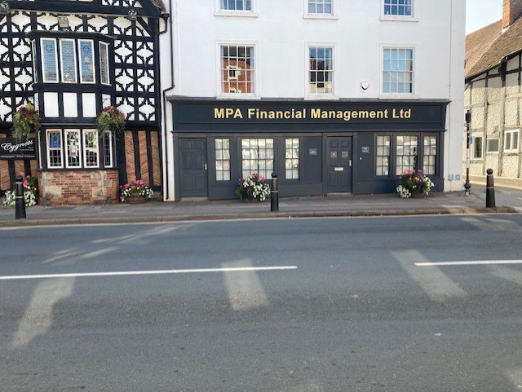
High Street Blue Badge Parking
To assist the Disabled / Blue Badge Parking, there does need to be an additional 1 bay located right outside MPA company, and the existing 1 bay turned to 2 outside J Cranmer This was discussed with WCCHD and would only require a small amount of work to approve
This will give the frail / infirm and disabled access to the Chemists. Or the White Swan

Slide 10
Parking Issues at our other Car Parks
A study needs to be completed and identify the best solution for our parking issues at the towns car parks
Suggestions for making it better. Prince Harry / Medical Centre eg: An In and Out, or 1 way system
Payment for this Car Park
Medical staff to not park in the Patients section for all day.
Introducing payment for the other towns car parks so they are all in sync.
Stopping illegal parking
Bringing everything about our car parks to be the same

Slide 11
Long Term Strategy
Back to the meeting in November with WCC we did discuss many options to try and alleviate the issues of the Henley Pinch Points
Additionally, the council did highlight that proposals being put forward, would have a serious cost implication that we as the JPC would have to pay for

Slide 12
Strategy Proposals
One of the proposals that the WDC did seem to accept was the removal of 50% of the pavement outside the old Barclays Bank. This would ease congestion when there are deliveries to the shops
A full feasibility study with drawings would need to be carried out by WDC and thus analysed. This however is at a far more understandable figure of £1000
To alter the road at this point would be expensive, thus some solutions would need to be found to highlight this issue, or find ways that this can be funded.

Slide 14
Proposals for Future
Ian and myself are willing to again cause WDC a rather painful headache with the background work to propose the changes
Discuss with the vendors of the best least disruptive loading times
Push the WDC to implement the changes to stop parking by cars in this area
Gain approval for the feasibility study to be actioned by WDC
Discuss the future long term with the joint team for the housing development
The proposals whatever is decided will be to find / implement ways to ensure that our town center does not die, as we cannot let that happen
Ensure all the findings are reported / actioned upon by the JPC

